Slide 1





Marketing Plan
Product-SPEAK EASY

Slide 2
Marketing Plan
Product-SPEAK EASY

Slide 3
Table of Contents
01 Introduction
03 Marketing Matrix
Introduction to Speak Easy Concept
Briefly discussion on marketing Strategies
02 Objectives
04 Blueprint
Discuss about the Pain points and Target Audience
Brief schedule for launching

Slide 4

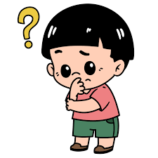
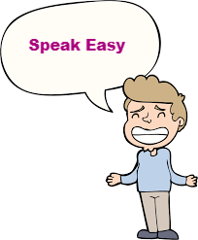
INTRODUCTION
We believe in transforming children's lives by changing maladaptive behavior, enhancing self-awareness, and taking a stance against social media addiction.
Our evidence-based methodology combines concepts of social human development and learning through engaging, fun elements like cartoons, games, books, and videos.
But “Generation Z” are struggling a lots with stress, anxiety that lead to severe depression and this result in criminal activities more times than not. So, What is the Solution??

Slide 5


We discover the product SPEAK EASY.Through our in-depth workshops, we provide resources that foster social interactions, healthy reactions, and forming lasting friendships. We're here to support children, teenagers, and adults as they navigate life's challenges.
Active Listener’s is a website which we are launching by the first week of August. Through Speak Easy therapy session, kids and parents can go through our website and can freely speak with our Psychologist. This will improve soft skills and hard skills of a child.
Illustrated video is attached.

Slide 6

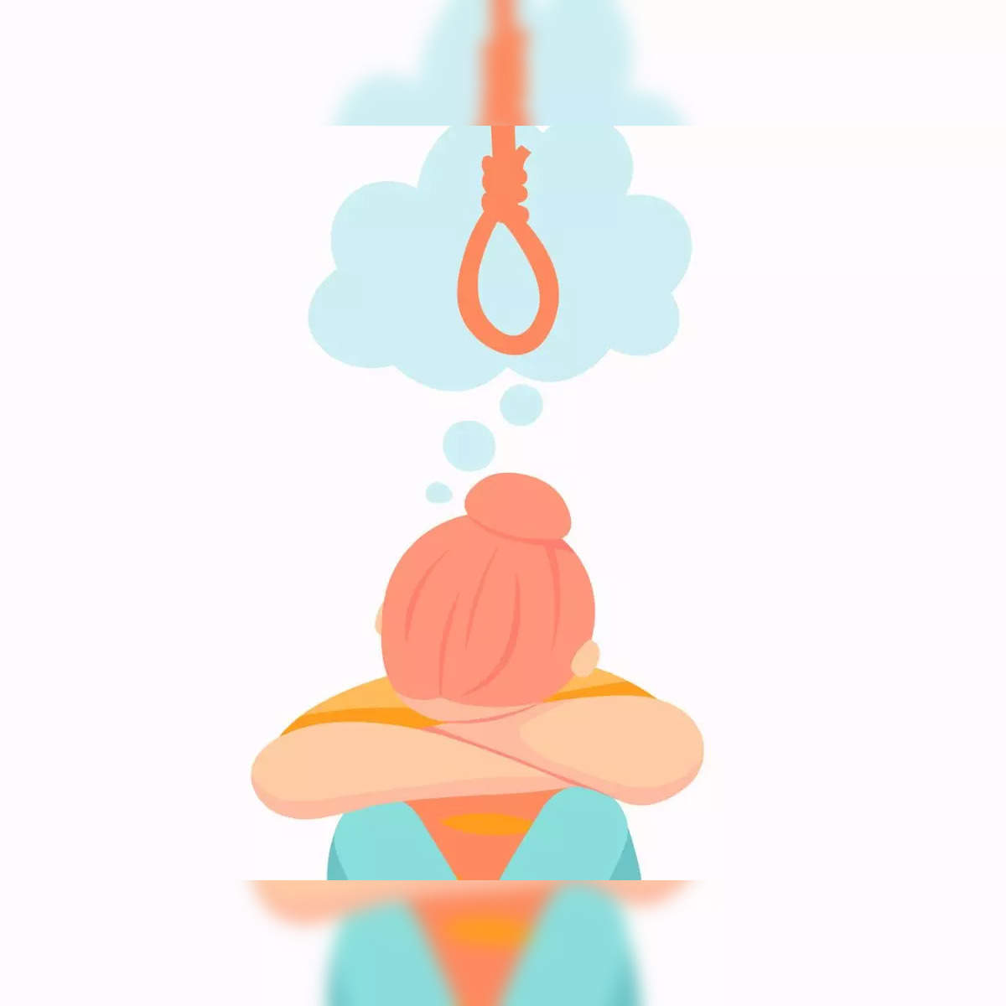
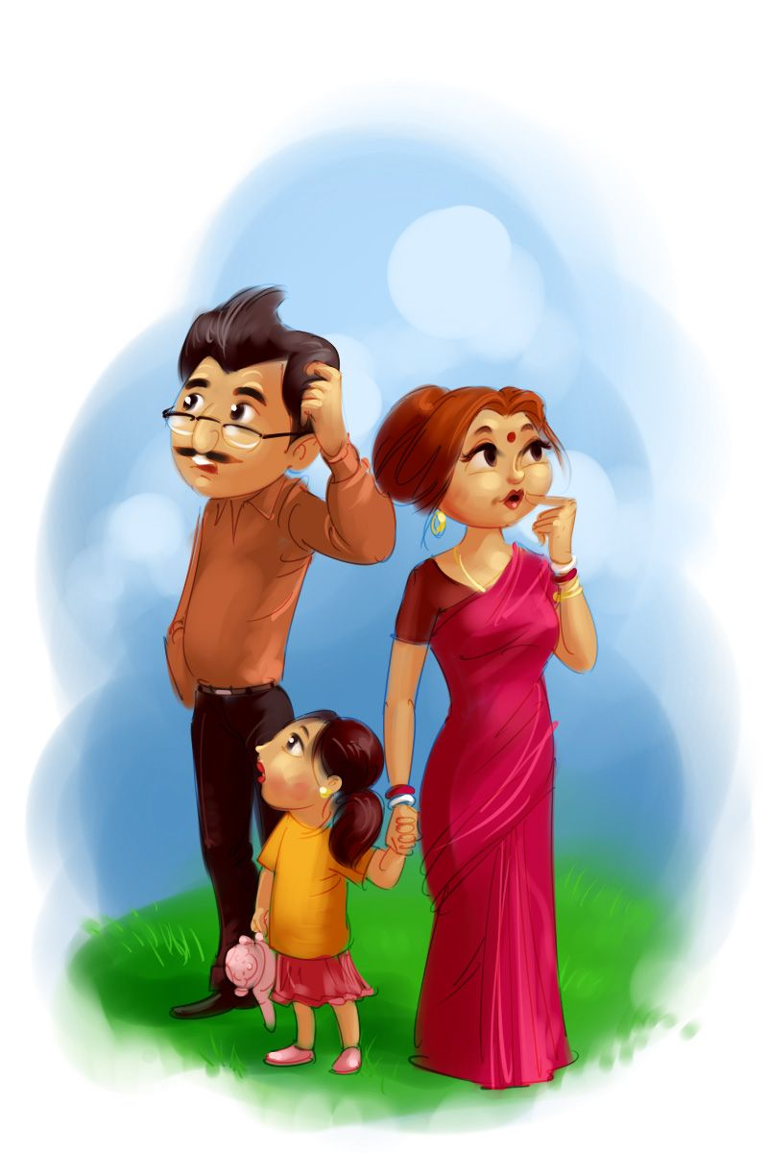
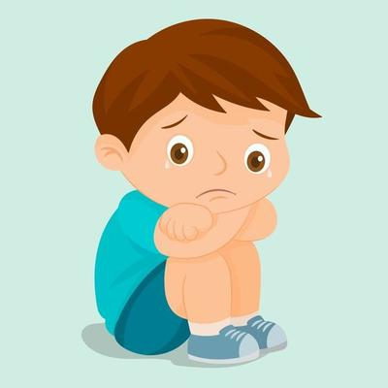
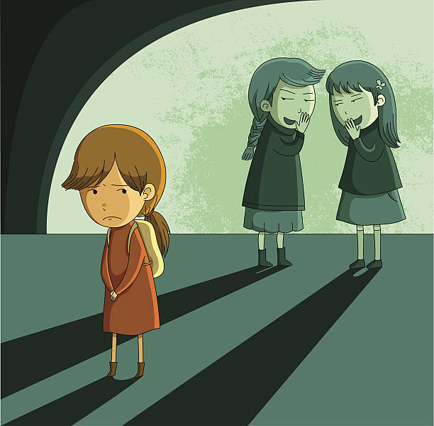
Pain Points
OBJECTIVES
Ensuring children's safety and well-being in an increasingly digital world presents ongoing challenges and concerns for today's parents.
.

Slide 7
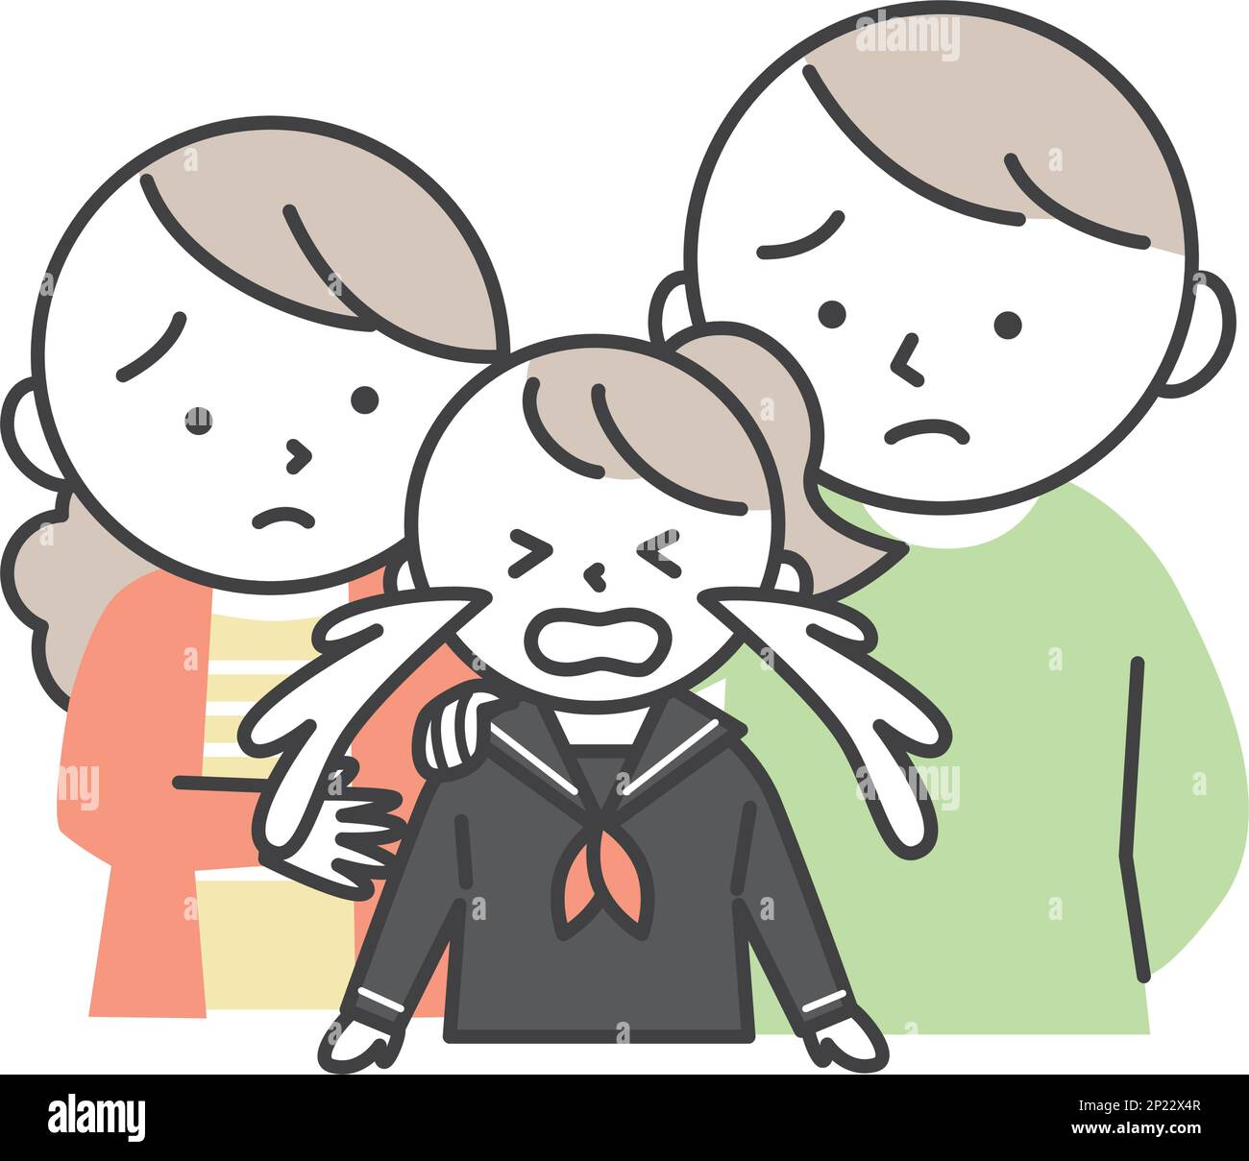
List of Pain Points
DEPRESSION
CRIMINAL ACTIVITY
Depression in children can lead to severe emotional, behavioral, and academic impact, crash their development and quality of life.
Engaging in illicit behaviors online can also expose kids to exploitation, manipulation, and long-term psychological harm.
INTROVERT
POOR HEALTH
The pressure to conform to extroverted norms can cause introverted kids to experience anxiety and low self-esteem.
Poor health in children can hinder their physical growth and cognitive development, impacting their ability to thrive academically and socially.

Slide 8
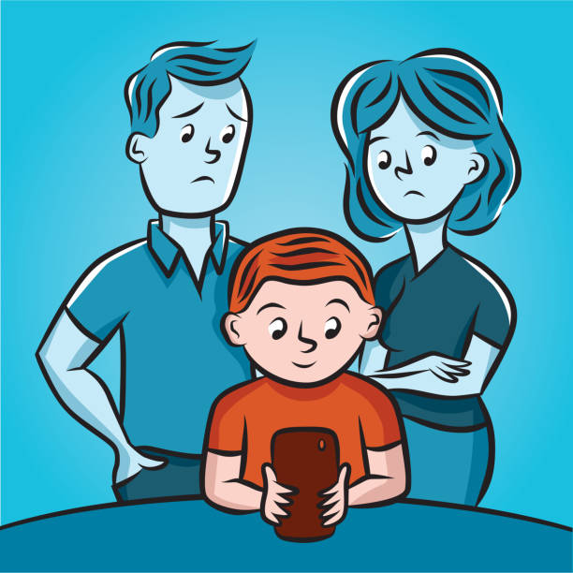
ACADEMIC PRESSURE
FAMILY DYNAMIC’S
Overemphasis on academic performance may hinder holistic development, stifling creativity, curiosity, and emotional healthy in young learners.
Dysfunctional family dynamics can lead to stress, instability, and adverse psychological outcomes in children.
HOOKED ON SOCIAL MEDIA
PEER PRESSURE
Peer pressure can influence children to engage in risky behaviors or make choices contrary to their values, leading to negative consequences.
Excessive use of social media can disrupt children's sleep patterns, impairing their cognitive function and academic performance.

Slide 9
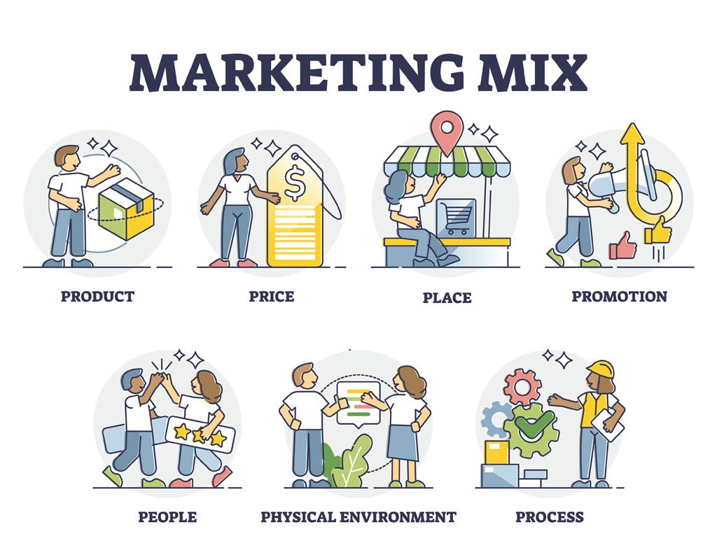
MARKETING
MATRIX
Marteking Strategies
Digital marketing strategies encompass a range of tactics aimed at enhancing online presence and driving engagement.
Incorporating these strategies cohesively can significantly boost brand visibility, customer acquisition, and overall business growth.

Slide 10

PLAN
ACT
To help the kids ad youngstres who suffer from severe depression. Our top psychologist will speak to them and allow them to speak freely + plus cure the with zero medication
Detailed analysis of
1) Entertain
2)Educate
3) Convince
4) Inspire.
REACH
CONVERT
We target the some specific age group with specific senarios
1) age= 6-12 (Early age of gadget exposure)
2) age= 13-19(Adaptation to mobile)
3) Post covid affected generation
Very easy, low budget and very affordable to avail the speak easy programme

Slide 11


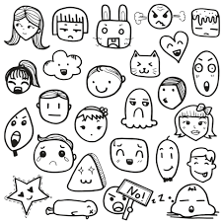
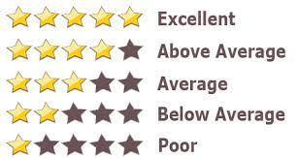




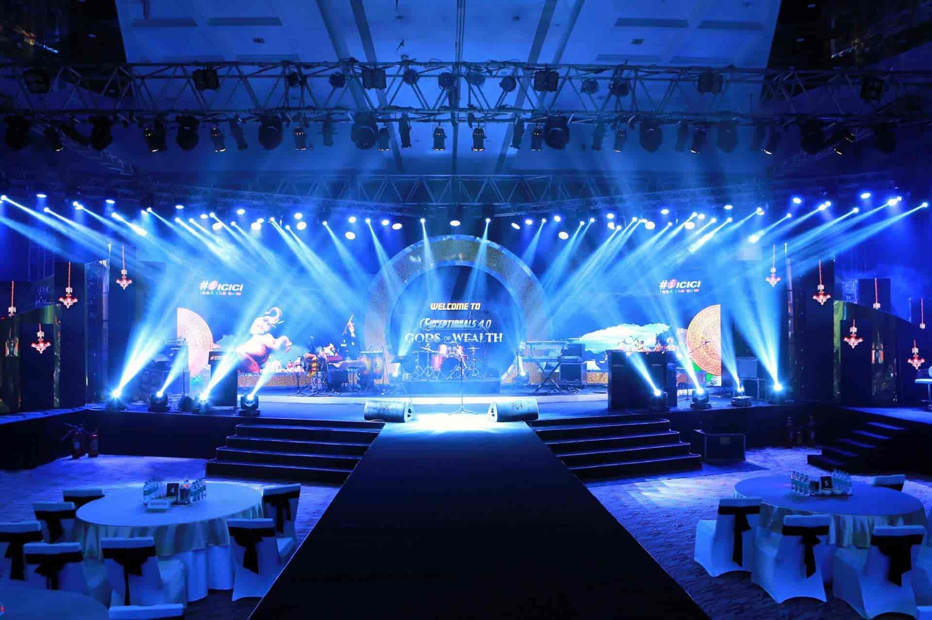

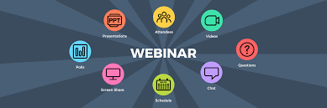



1) ENTERTAIN Viral Doodling Competetion Bullet Journaling Widgets | 4) INSPIRE Feedbacks Ratings Follow-up
2) EDUCATE Articles Infographics Posters | 3) CONVIENCE Events & Demo’s Webinars Price Guide Case Studies

Slide 12

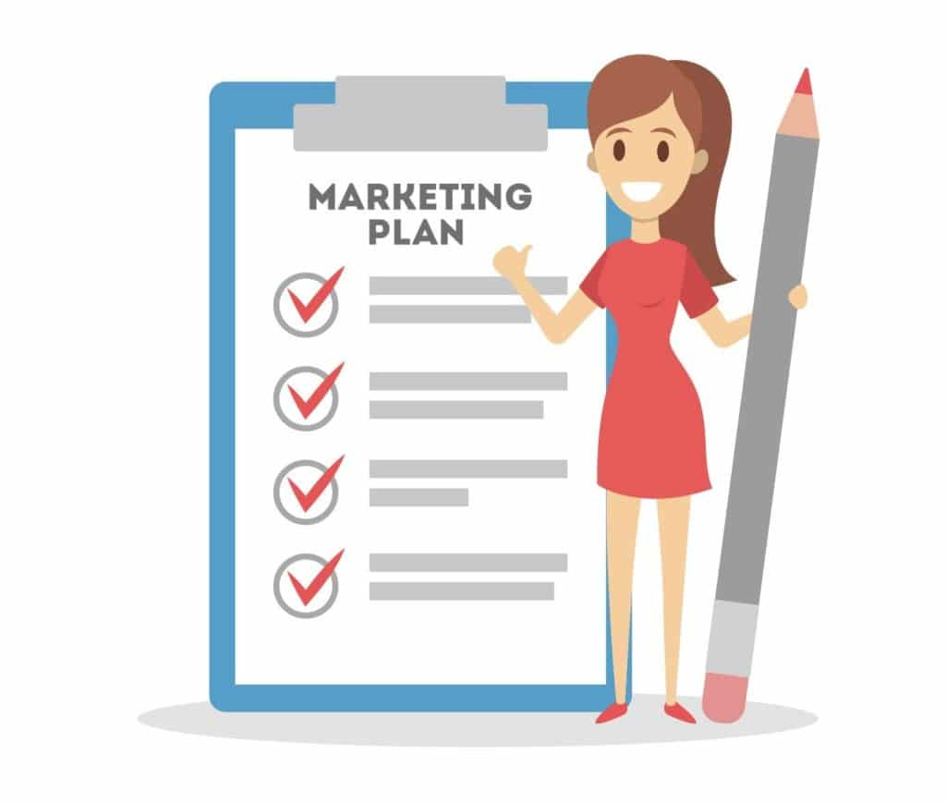
Road Map
BLUEPRINT
A digital marketing roadmap outlines a strategic plan to achieve specific online marketing goals through a series of actionable steps.
Develop a content strategy that includes blog posts, videos, and social media content tailored to your audience's interests and needs.

Slide 13
Date Wise Road Map
MONTH | MAY | JUNE |  | JULY |  |  | AUG
DATE | 20-31 | 3-14 | 17-28 | 1-12 | 15-26 | 29-31 | 1st week
MILESTONE’S | Beta-Testing | Reel+trac-king of SEO | Release of Articles | Events+Demo’s | Webinar+Case study+ SEO | Final Testing+SEO | Release of Product

Slide 14


FEATURES
GOALS
1) One on one session with Psychologists
2) Involvement of different age group of kids and youngsters
3) Involvement of parents
4) Podcast to refersh mind
5) Budget and user friendly
#.7 days-₹999 (4session with kids 2 session with parents)
#. 15 days-₹1999 (8session with kids 4 session with parents
#. 30 days-₹2999 (16session with kids 8 session with parents
1) Remove mobile addiction.
2) Cure from depresion without zero medication.
3) Build of strong gut feelings and trust.
4) To reach this produc to every kids and oungsters even in the rural areas.

Slide 15

Our wounds are often the openings into the best and most beautiful part of us.
and to make our wound better
We need to make mental health as important as physical health.

Slide 16


